Slide 1
Introduction to OOP: Class and object
Pemrograman Berorientasi Obyek

Slide 2
CLASS

Slide 3
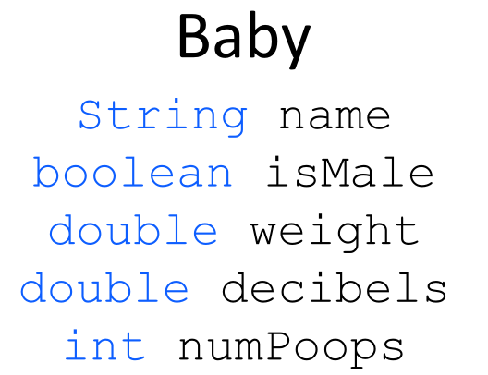

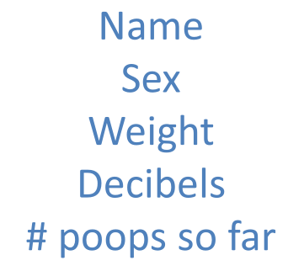
OOP
Represent the real world: Baby

Slide 4
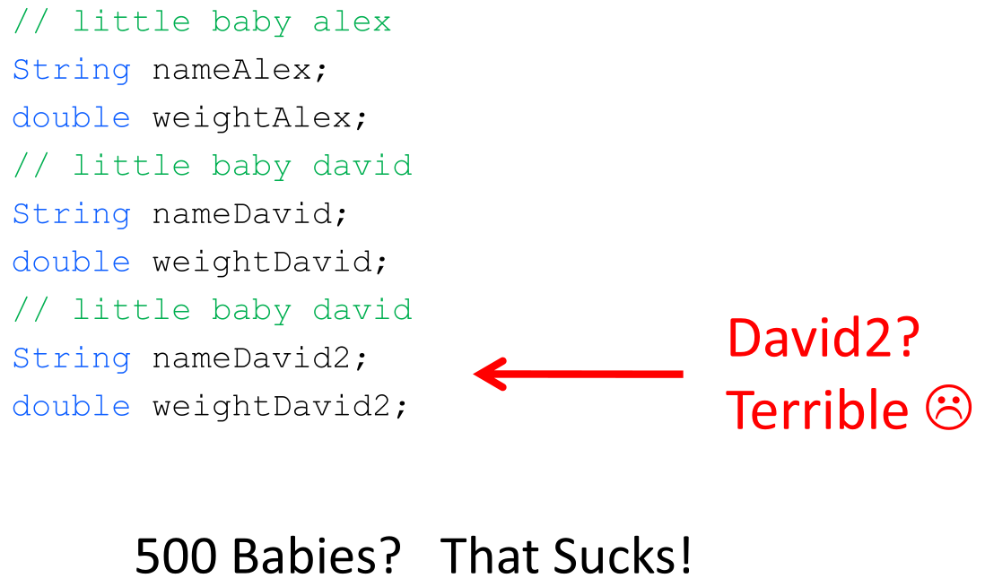
Why use class?

Slide 5
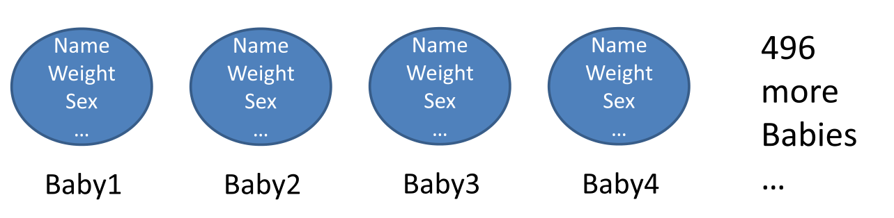
Cont.

Slide 6
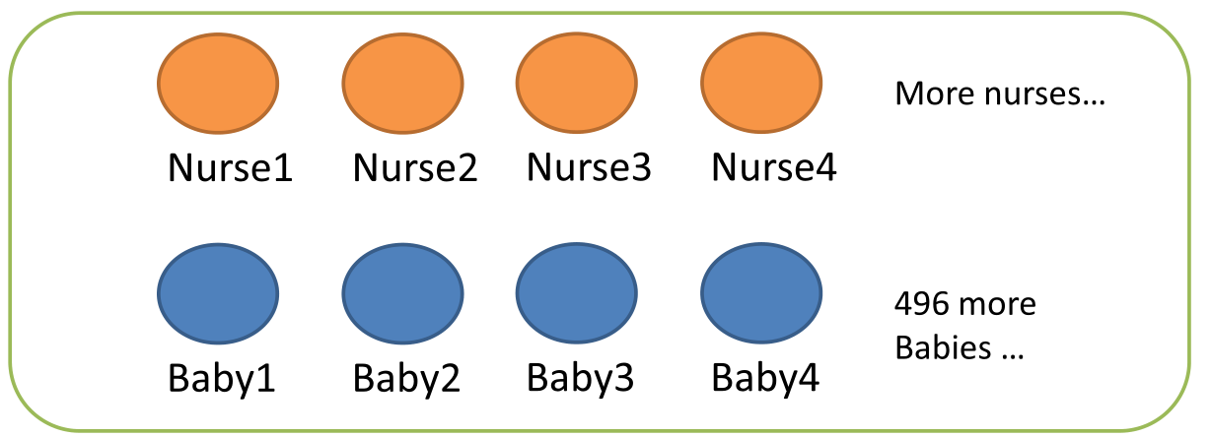
Cont.

Slide 7
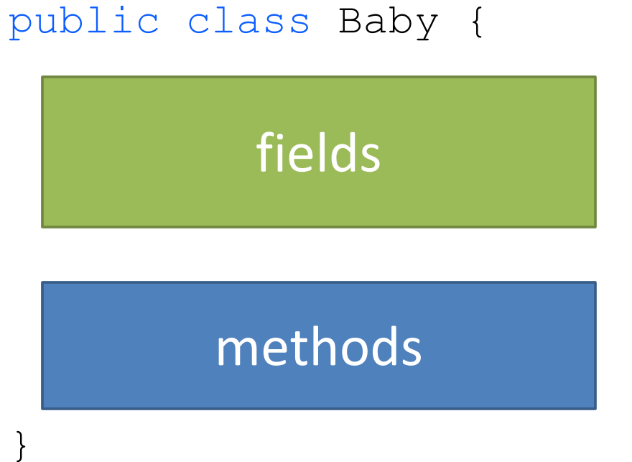
Creating Class

Slide 8
Notes
Class name is capitalize
1 class = 1 file
Having main methods means the class can be run

Slide 9
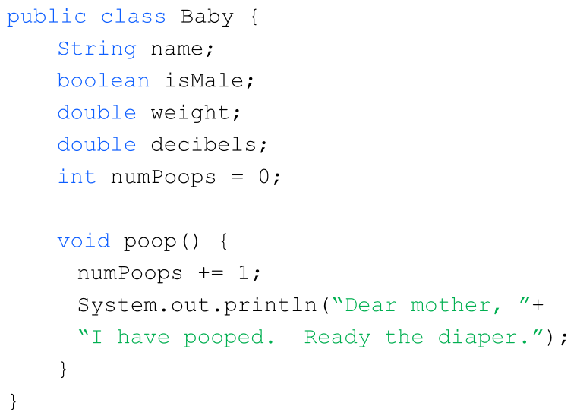
Writing class

Slide 10
Design Class
Start from concrete object then generalize
Things that object know
Things that object does

Slide 11
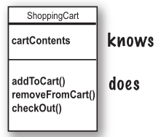
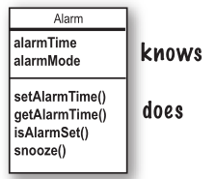
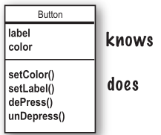
Example

Slide 12
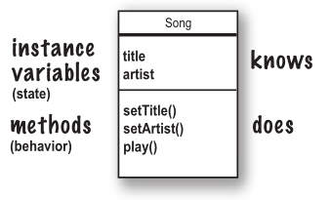
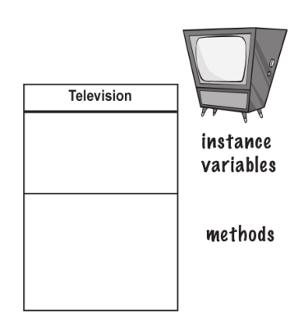
Cont.

Slide 13
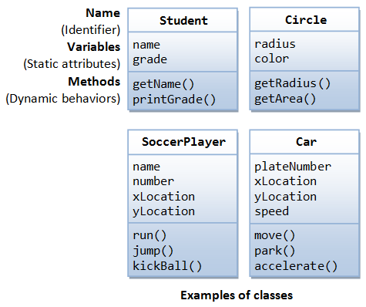
Cont.

Slide 14
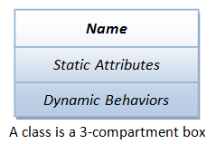
Summary
a class is a definition of objects of the same kind
Name (or identity): identifies the class.
Variables (or attribute, state, field): contains the static attributes of the class.
Methods (or behaviors, function, operation): contains the dynamic behaviors of the class.

Slide 15
OBJECT

Slide 16
Making your first object
Write your class
Write tester (driver) class
In your tester, make an object and access the object’s variable and methods

Slide 17
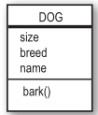
Write class
class Dog{
int size;
String breed;
String name;
void bark(){
System.out.println(“Wof! Wof!”);
}
}

Slide 18
Write tester/driver class
class DogTest {
public static void main (String[] args){
// test will be in here
}
}

Slide 19
Write test
class DogTest {
public static void main (String[] args){
Dog d = new Dog(); // make object (term: instantiate)
d.size = 40; // set size of dog
d.bark(); //call bark methods
}
}

Slide 20
Let’s create baby
// create “myBaby” object from class Baby
Baby myBaby = new Baby();
myBaby.name = “Sarah”;
…

Slide 21
Two use of main
Test your real test
It is possible to have main in each class to test class itself
To launch/start your java Apps
main is entry point

Slide 22
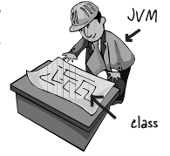
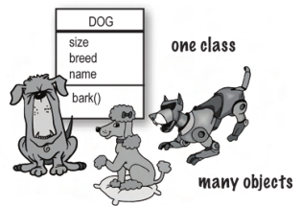
Class is not object
One class, many objects
Class used to construct objects (using new keyword)
Class is “blueprint” or “recipe” for object

Slide 23
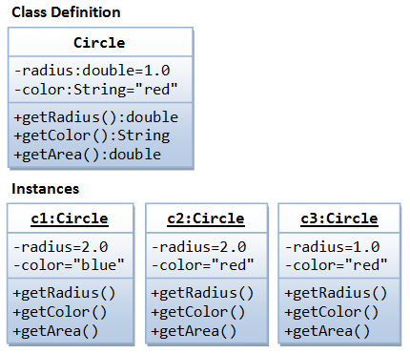
Example

Slide 24
Assignment
Write guess program:
class GuessGame (driver/launcher)
class Guess
Field: numGuess,…
Method: checkResult, …

Slide 25
Variable

Slide 26
OOP Characteristics
Everything is an object
A program is bunch of objects telling each other what to do by sending messages
Each object has its own memory made up of other object
Every object has a type
All object of particular type can receive the same message
Notes:
Compare to procedural language

Slide 27
More compact definition
An Object has state, behavior and identity

Slide 28
Quiz!!!
Define class and object with your own word!
What is difference between class and object?
List 2 use of main methods?
Write Car class:
Field: xLoc, yLoc, plateNum, speed
Methods: move(), accelerate()
Write TestCar class to test Car class

Slide 29
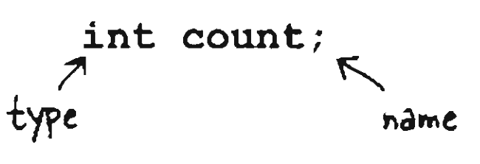
2 Rule for variables
Variable must have type
Variable must have a name

Slide 30

What variable does?
Variable is just a cup
A container. It hold something

Slide 31
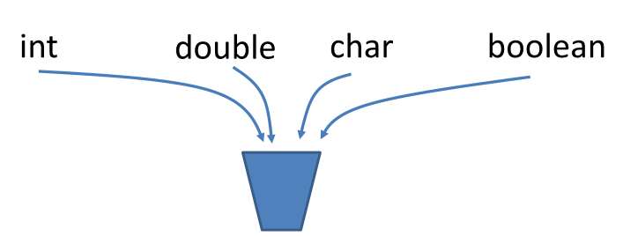
Primitive type variable
int, long, double, boolean, char, short, byte, float
The actual values are stored in the variable
Primitives are small enough that they just fit into the cup

Slide 32
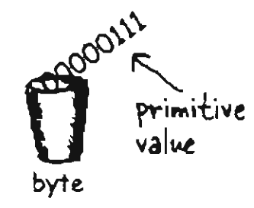
Example
byte x = 7;

Slide 33
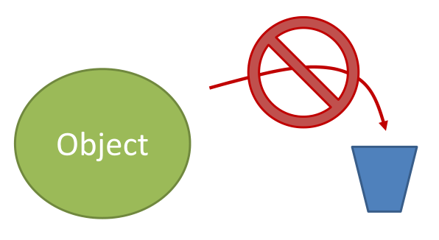
Reference type variable
Everything except primitives type: object, array
Objects are too big to fit in a variable (cup)

Slide 34
Cont.
There Is actually no such thing as an object variable
There's only an object reference variable
An object reference variable holds bits that represent a way to access an object
It doesn't hold the object Itself, but It holds something like a pointer (but not pointer like c)

Slide 35
You manipulate object with reference
Although you treat everything as an object, the identifier you manipulate is actually a “reference” to an object.
You might imagine a television (the object) and a remote control (the reference).
As long as you’re holding this reference, you have a connection to the television, but when someone says, “Change the channel” or “Lower the volume,” what you’re manipulating is the reference, which in turn modifies the object.
If you want to move around the room and still control the television, you take the remote/reference with you, not the television.

Slide 36
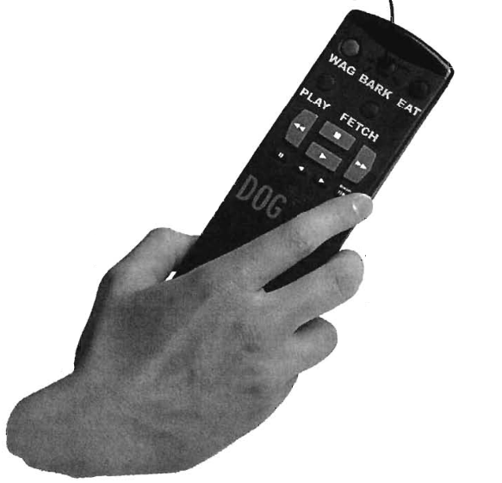
Reference as remote

Slide 37
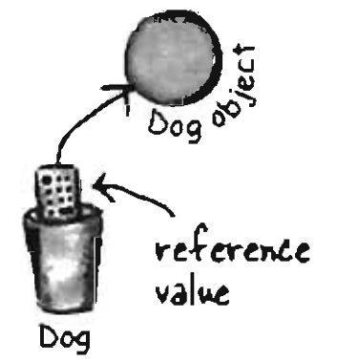
Example
Dog myDog = new Dog();

Slide 38
3 Steps Object creation
Declare reference variable
Dog myDog;
Create an object
new Dog()
Link object to reference
Dog myDog = new Dog();

Slide 39
Where program lives
Register (inside processor)
The stack (in RAM but have direct support from processor)
The heap (also in RAM, very flexible)
Constant storage (ROM)

Slide 40
3 things to remember
Instance variable and object live on heap
Local variable live on stack

Slide 41
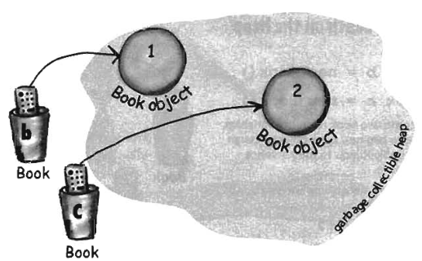
Life and death of object
Book b = new Book();
Book c = new Book();

Slide 42
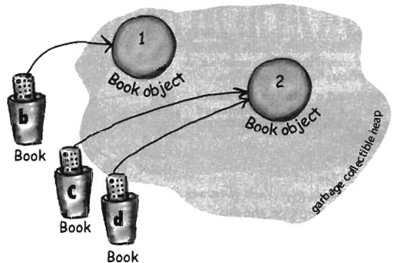
Cont.
Book d = c;

Slide 43
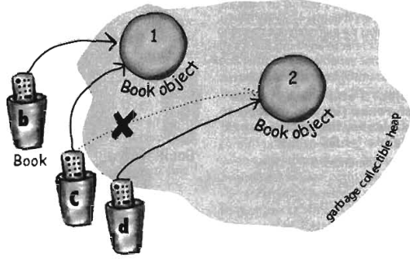
Cont.
c = b;

Slide 44
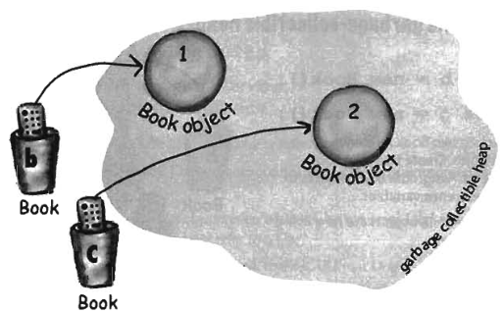
Cont.
Book b = new Book();
Book c = new Book();

Slide 45
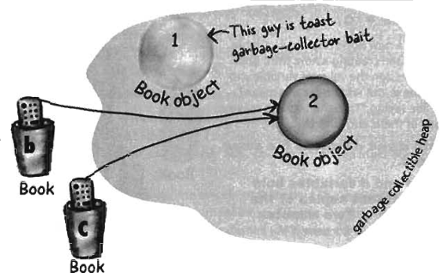
Cont.
b = c;

Slide 46
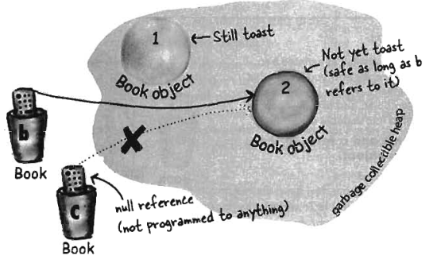
Cont.
c = null;

Slide 47
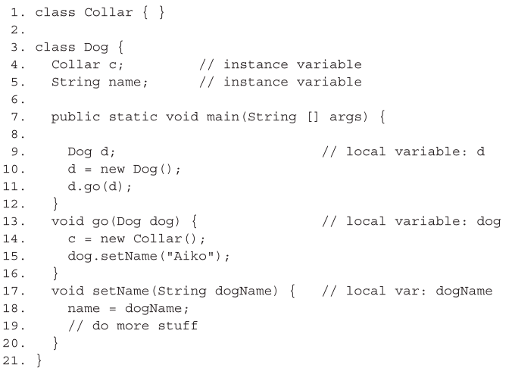
Complex example

Slide 48
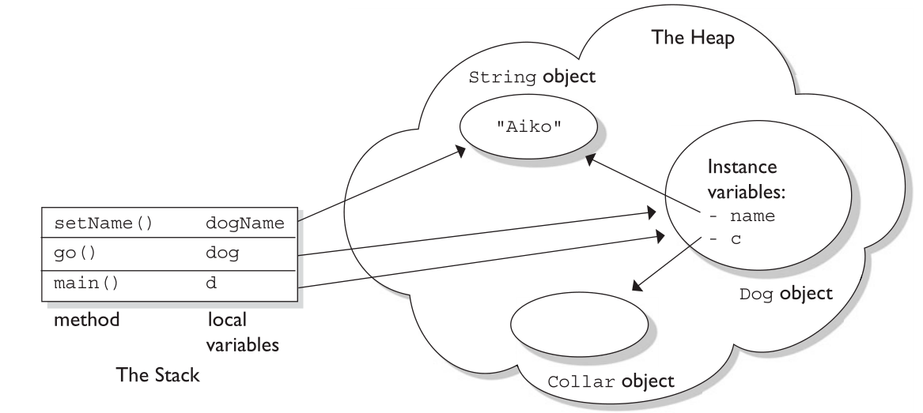
Ilustration (create animation)

